Slide 1


5G Technology
5G is the fifth generation of mobile networks that promises faster speeds, lower latency, and greater capacity than its predecessor. In this presentation, we will explore the benefits, applications and challenges of this transformative technology.

Slide 2

Health Concerns with 5G Technology
While the benefits of 5G technology are many, there are also concerns about its potential health effects. As we continue to roll out this transformative technology, we must also be mindful of the possible risks and take steps to address them.
Some of the main health concerns associated with 5G technology include:
Increased exposure to electromagnetic radiation
Potential effects on human cells and DNA
Possible interference with medical devices
Unknown long-term health effects
It is important to conduct further research and ensure that safety measures are in place to protect public health as we embrace the advancements of 5G technology.

Slide 3
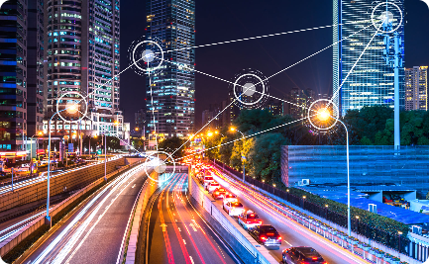
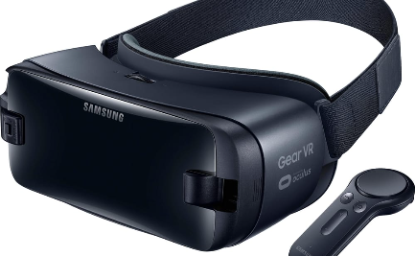
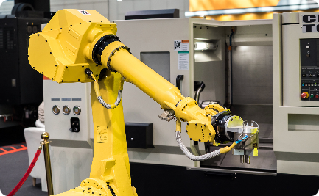
A Faster, More Connected World
Smart Cities
Entertainment
Manufacturing Automation
5G networks will enable seamless connectivity between devices and infrastructure, creating efficient, safer and more sustainable urban environments.
With 5G, we can expect a new revolution in immersive entertainment experiences, such as virtual and augmented reality.
5G will also enable advanced automation in factories and warehouses, transforming industries such as logistics, manufacturing and robotics.

Slide 4
Empowering the Internet of Things (IoT)
Smart Homes
Connected Cars
Remote Monitoring
5G networks will enable seamless connectivity between devices and infrastructure, creating efficient, safer and more sustainable urban environments.
5G will enable advanced vehicle-to-vehicle and vehicle-to-infrastructure communication, creating safer and more efficient transportation systems.
5G will enable remote monitoring of equipment, infrastructure, and even our bodies, creating new opportunities in healthcare and other sectors.

Slide 5
Driving Autonomy and Innovation
1
Level 5 Autonomy
5G networks will enable fully autonomous vehicles, creating new opportunities for safety and efficiency on our roads and highways.
2
Smart Agriculture
5G networks will enable smart agriculture, revolutionizing the way we grow and harvest crops and distribute food.
3
Real-time Gaming
With 5G, gamers can expect a revolution of real-time interactive experiences with higher-quality graphics and smoother interactions.

Slide 6
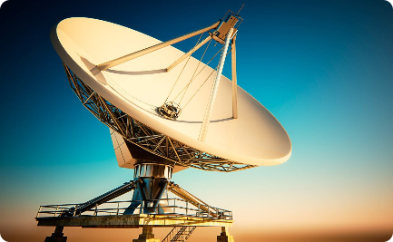

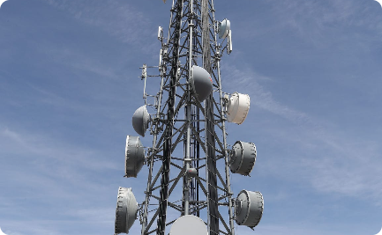
Challenges Ahead
Infrastructure
Security and Privacy
Spectrum Availability
Building the necessary infrastructure to fully realize 5G's potential will be expensive and challenging, particularly in rural or remote areas.
As the number of connected devices grows, so does the risk of cyberattack and data breaches.
5G networks require significant spectrum allocations that may conflict with other uses, such as military or scientific research.

Slide 7

The Future of 5G
1
More Coverage
2
New Use Cases
5G networks will soon be available in most major cities across the U.S. and other countries, with faster and more stable connectivity.
5G technology will give rise to new use cases we have not yet envisioned, such as remote surgery and advanced VR/AR experiences.
3
Further Evolution
The development of 5G will not stop here; we can expect continuous advancements and integration with other emerging technologies such as blockchain and AI.

Slide 8

Continued Evolution towards 6G and Beyond
As we look to the future, the evolution of wireless technology does not stop at 5G. The industry is already exploring the possibilities of 6G and beyond, envisioning even faster speeds, lower latency, and groundbreaking applications that will shape our digital landscape.

Slide 9

Security:
As we embrace the advancements of wireless technology, ensuring robust security measures becomes paramount. Protecting sensitive data, safeguarding privacy, and preventing cyber threats are critical in this interconnected world. Let's explore how we can enhance security and build a safer digital future.

Slide 10

Conclusion
5G technology represents a fundamental shift towards a more connected and intelligent world. While it poses significant challenges and concerns, it holds immense potential for innovation and growth in various industries. We must work together to ensure its safe and equitable deployment for all.

